Slide 1
Kubernetes Failure Prediction using LSTM
Team name : Mutta Puffs Team Members: K.Athmapriyan K.Varshat
S.Ashvidha
Muthukumar
Joshitha

Slide 2

Problem Statement
Kubernetes is widely used for container orchestration but suffers from unexpected failures.
Failures lead to downtime, resource wastage, and performance degradation.
Need for predictive analysis to mitigate risks and optimize performance.

Slide 3

Solution Overview
Machine Learning Model trained on Kubernetes performance metrics.
Uses LSTM (Long Short-Term Memory) networks for time-series prediction.
Helps predict failures before they occur and enables proactive responses.
Reduces system downtime by detecting anomalies early.
Improves resource allocation by identifying inefficiencies in CPU, memory, and disk usage.

Slide 4
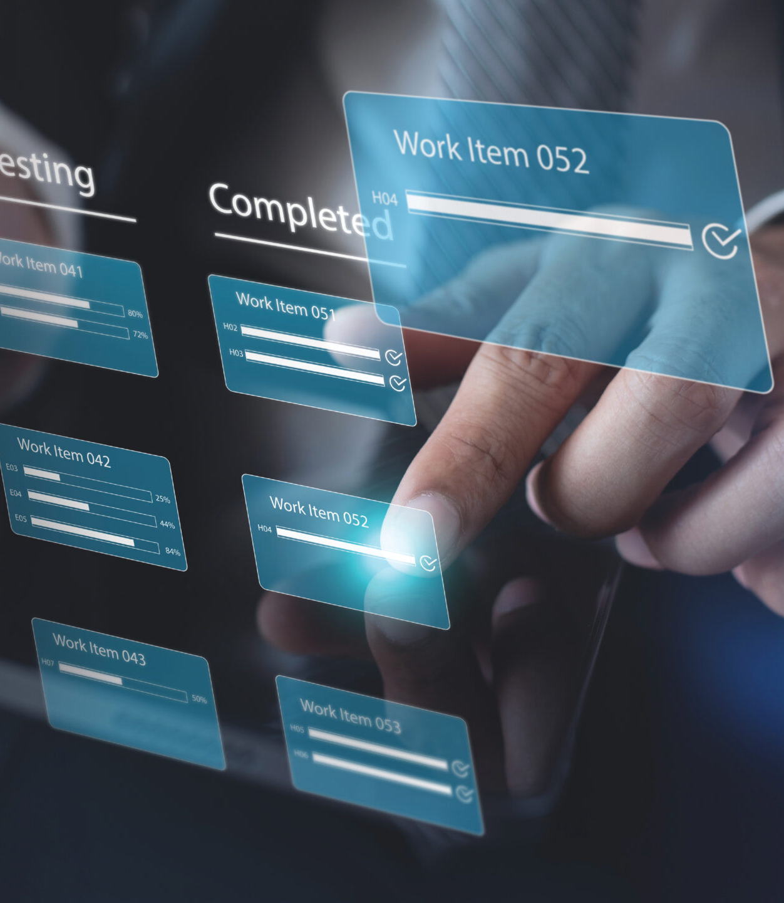
Technical Implementation
Dataset: Kubernetes logs with CPU, Memory, Pod Status, Network IO, Disk Usage.
Preprocessing:
Data Normalization using MinMaxScaler.
Sequence preparation for LSTM model.
Model:
LSTM layers for time-series learning.
Dense layers for final predictions.
Tools & Libraries: TensorFlow, Pandas, Matplotlib.

Slide 5
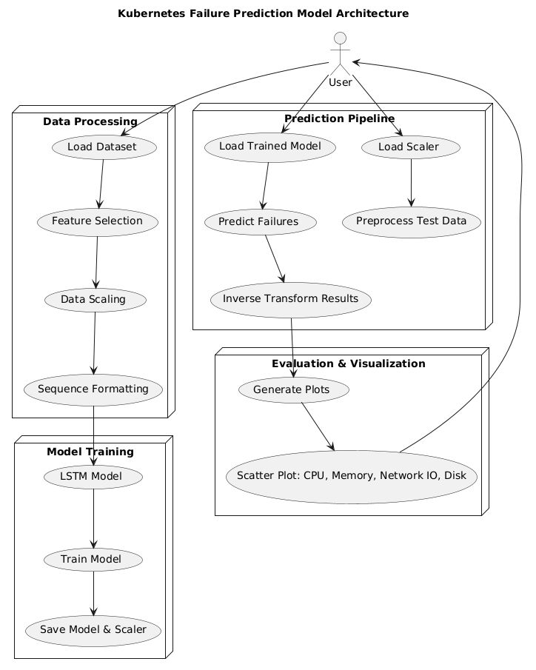
Model Architecture
Diagram: Kubernetes Failure Prediction Model Architecture
Components:
Data Processing: Loading dataset, feature selection, data scaling, and sequence formatting.
Model Training: LSTM model training and saving the trained model and scaler.
Prediction Pipeline: Loading trained model, preprocessing test data, predicting failures, and inverse transforming results.
Evaluation & Visualization: Generating plots for CPU, Memory, Network IO, and Disk Usage.
Flow: Kubernetes Metrics → LSTM Model → Prediction & Visualization.

Slide 6
Training Process & Evaluation
Hyperparameters: Adam Optimizer, Loss function (MSE), Batch size.
Evaluation Metrics: Mean Absolute Error (MAE), Mean Squared Error (MSE).
Results:
Training loss reduction over epochs.
Performance comparison of predictions vs actual values.
Improvement in failure prediction accuracy over iterations.

Slide 7

Demonstration (Predictions & Visualizations)
Graphs for Each Metric (CPU, Memory, Disk Usage, Network IO, Pod Status).
Scatter plots with clear color differentiation for predicted vs actual values.
Insights from visualizations:
Identify anomaly trends.
Improve Kubernetes resource allocation.
Validate model predictions against historical data.

Slide 8
Development Process
Workflow
Data Collection
Preprocessing
Model Training
Deployment

Slide 9

Potential Impact
downtime by predicting failures in advance.
Optimizes Kubernetes cluster performance.
Scalability: Can be integrated into DevOps pipelines for real-time monitoring.
Future Enhancements:
Implement real-time failure alerts.
Connect with Kubernetes dashboards for live monitoring.
Explore reinforcement learning techniques for adaptive failure prediction.

Slide 10
Conclusuion
The Kubernetes Failure Prediction Model enhances system stability by proactively detecting failures using LSTM-based time-series analysis. It optimizes resource utilization, reduces downtime, and improves cluster efficiency. By analyzing key performance metrics, it enables smarter decision-making for Kubernetes management. Future improvements could focus on real-time alerts, deeper dashboard integration, and adaptive learning for even better failure prevention.

Slide 11
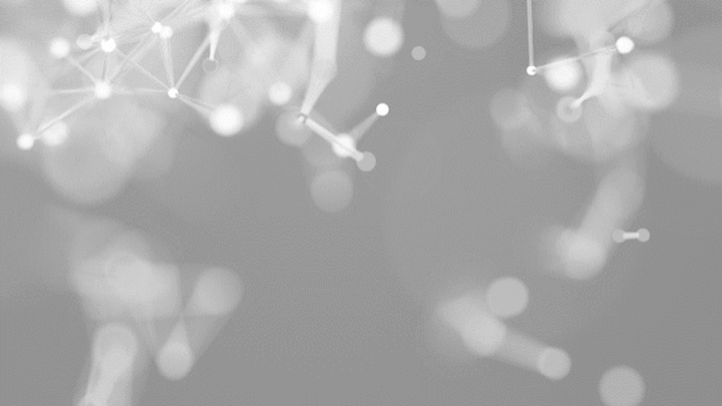
THANK YOU
Brita Tamm
502-555-0152
brita@firstupconsultants.com
www.firstupconsultants.com

